Slide 1
1
Food Distribution Program
WBSCM Reports Part II
Texas Department of Agriculture
USDA Division

Slide 2
Why WBSCM?
The FDP Module in TX-UNPS does not have an upgrade.
Since 2010, TDA has used the Web Based Supply Chain Management System (WBSCM) to submit RA orders to USDA.
USDA owns and regularly upgrades WBSCM, making it the best solution to serve RAs in Texas now and in the future.
Notes:
Review information on slide with RAs

Slide 3
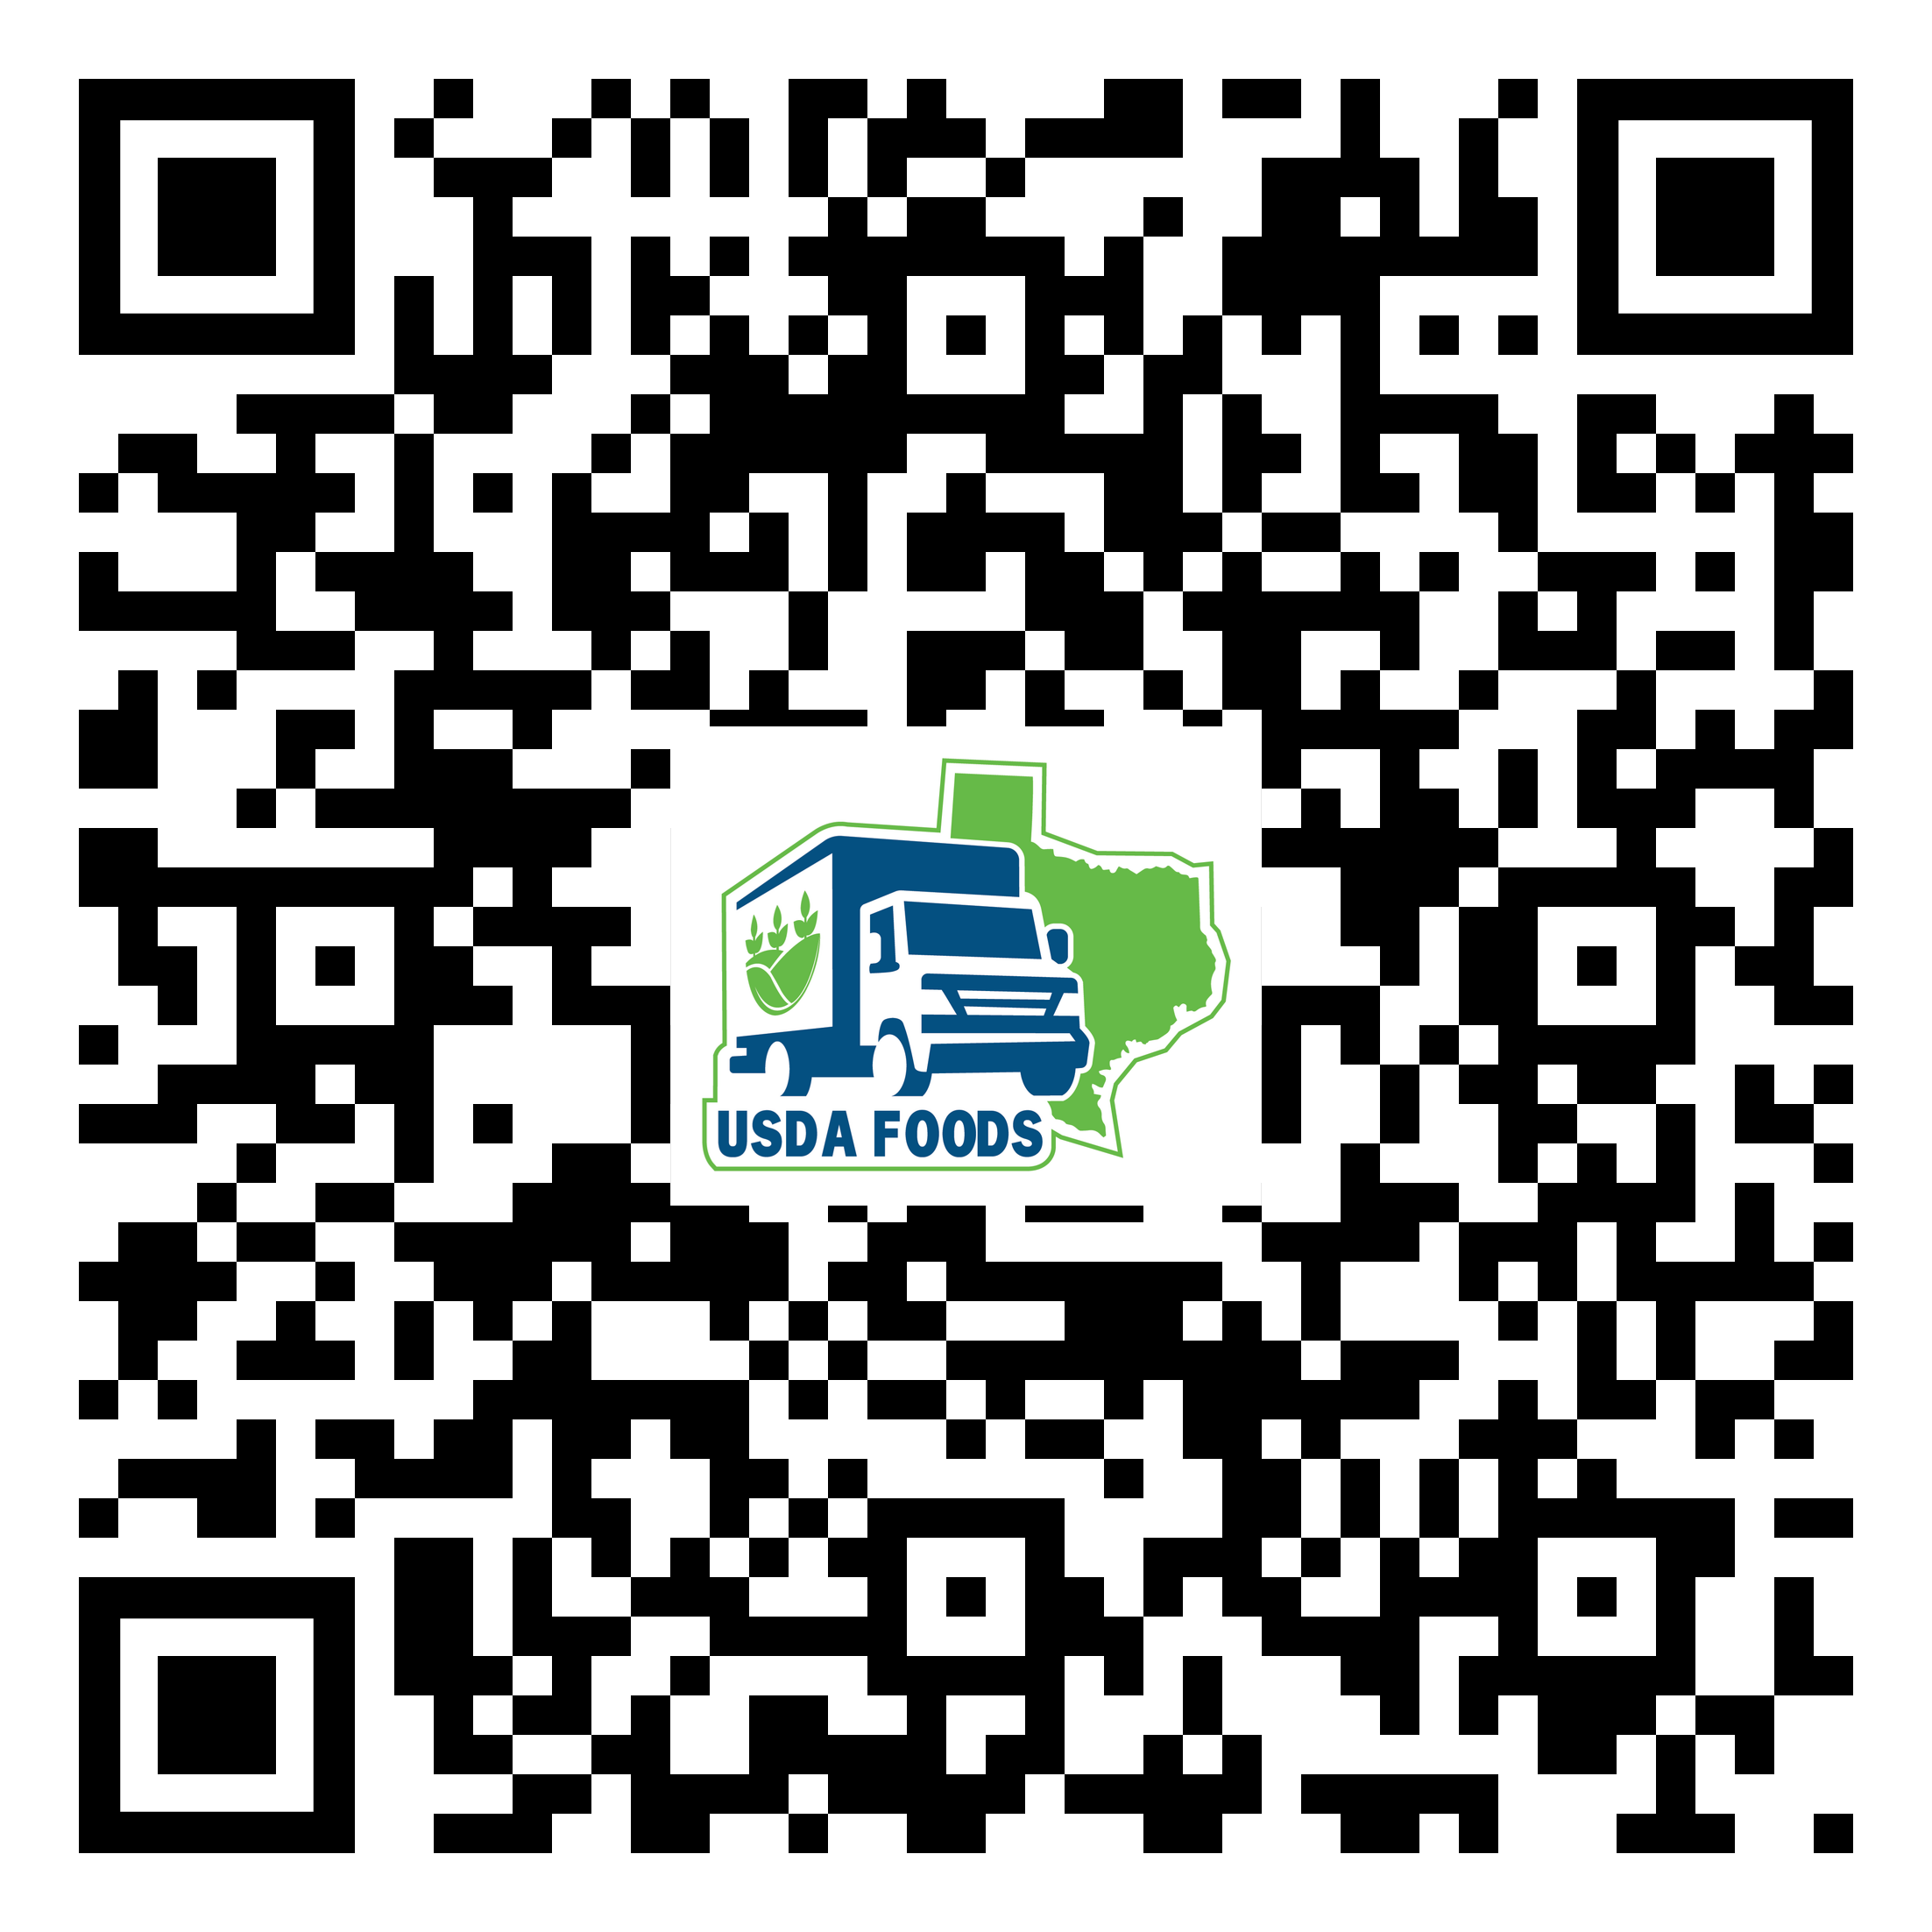
3
WBSCM Transition Page QR Code:
Scan QR Code to visit the Food Distribution Program WBSCM Transition website
Notes:
Review information on slide with RAs

Slide 4
01
Course Introduction
Course Outline and Objectives

Slide 5
5
Introduction
01
Course Overview and Objectives
02
Requisition Status Report
Monitor requisition activity through the order life cycle.
03
Value of Commodities Received –RA Report
Review value of all commodities received.
WBSCM Reports Part II:
Course Outline

Slide 6
6
Course Objectives and Outcomes
By the end of this course, participants will be able to:
Understand how to access and execute the Requisition Status Report and the Value of Commodities Received-RA Report
Identify related information for all materials requested
Understand how to use information to monitor activity of requisitions including material status and delivery schedules through the order life cycle
Understand how to view the value of all commodities received at processor and/or warehouse
Identify and understand Order Status Codes

Slide 7
7
02
Requisition Status Report

Slide 8
8
WHEN
WHY
Run this report after placing requisitions for materials in WBSCM.
To monitor the status and information for material line items through the order life cycle.
Notes:
Review information on slide with RAs

Slide 9
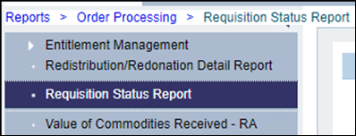
9
TX-UNPS Commodity Bulletin Equivalent
Shipments Expected into Warehouse (TXUNPS)
Weekly Commodity Bulletin
Reports Module in WBSCM
Requisition Status Report
Notes:
The information previously found in the Shipments Expected into this Warehouse section of the TX-UNPS Weekly Commodity Bulletin will be found in the Requisition Status Report as the FDP Module in TX-UNPS is being eliminated.

Slide 10
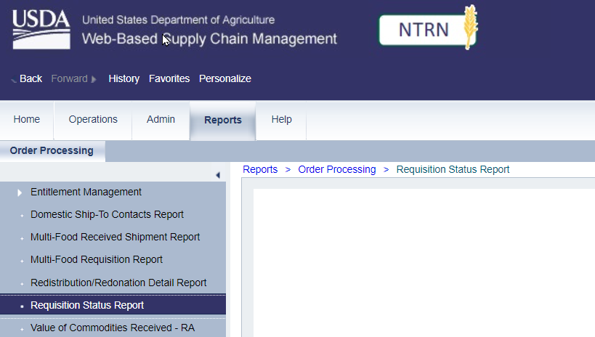
10
Running Requisition Status Report
To access the Requisition Status Report, follow the steps on each slide.
1
Click on reports
Notes:
To access the Requisition Status Report, follow the next set of steps on each slide.​ ​
RAs would run this report to view the status and relevant information for each item requested
​
More detailed information will be provided on report view slides.

Slide 11
11
Running Requisition Status Report
2
Click on Requisition Status Report
Notes:
Review information on slide with RAs

Slide 12
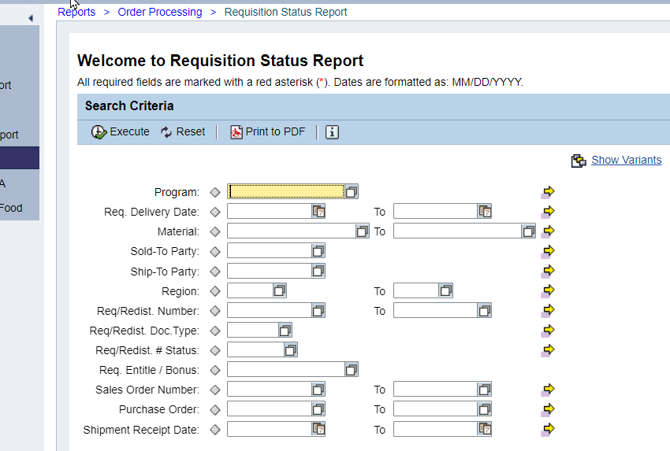
12
Running Requisition Status Report
3
Option 1: Type NSLP in Program Field
Option 2: To search, click on the Matchcode icon
Notes:
Review information on slide with RAs

Slide 13
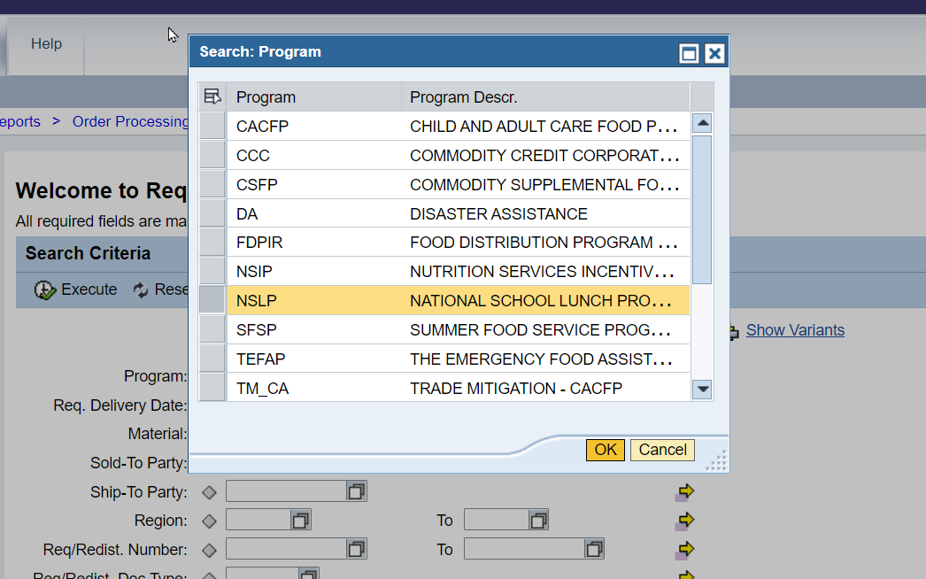
13
Running Requisition Status Report
3
Click on NSLP if searching using the Matchcode icon.
Notes:
Review information on slide with RAs

Slide 14
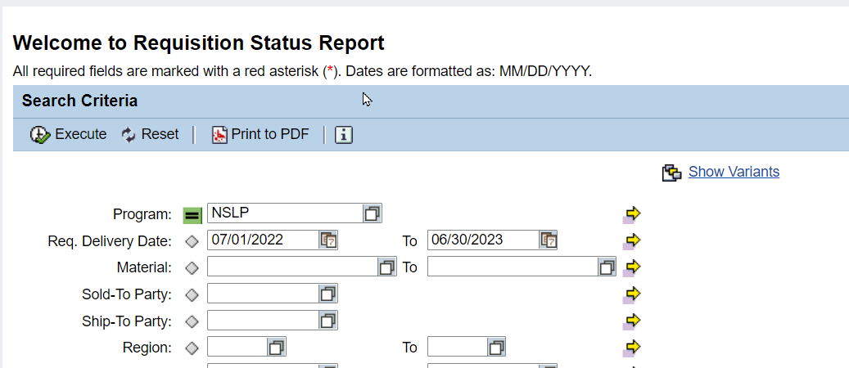
14
Running Requisition Status Report
4
Enter Date Ranges in Req. Delivery Date field.
*If current school year is 2022-2023, enter 07/01/22 to 06/30/23 as the date range.
Notes:
TRAINER NOTE: Staged data also available in NTRN for School Year 2023-2024. May use 2023-2024 date range if desired
No staged data exists for future School/Program Years yet.

Slide 15
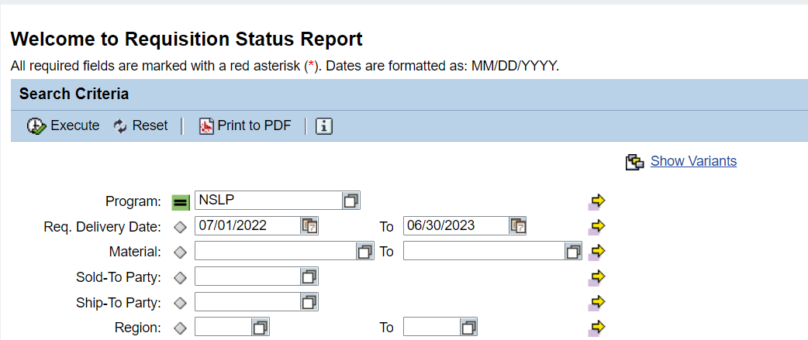
15
Running Requisition Status Report
5
Click Execute to run report
Notes:
Review information on slide with RAs

Slide 16
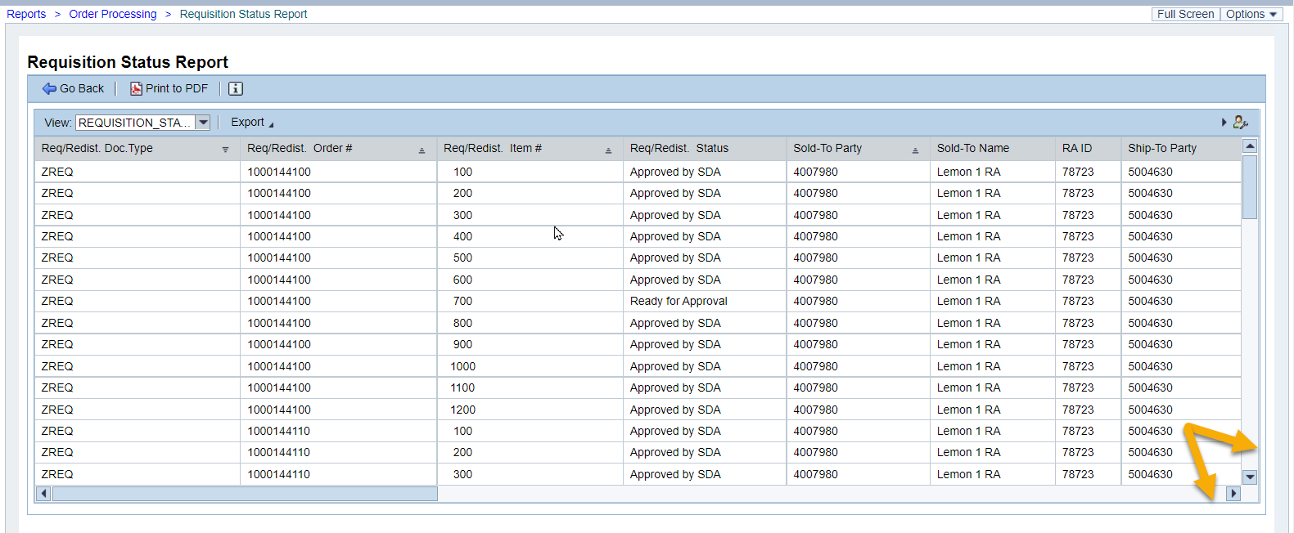
16
Running Requisition Status Report
Report will appear in the Main Content Area
Scroll to view all columns in The Main Content Area
Notes:
Review information on slide with RAs

Slide 17
17
Running Requisition Status Report
6
Click Export
Notes:
Review information on slide with RAs

Slide 18
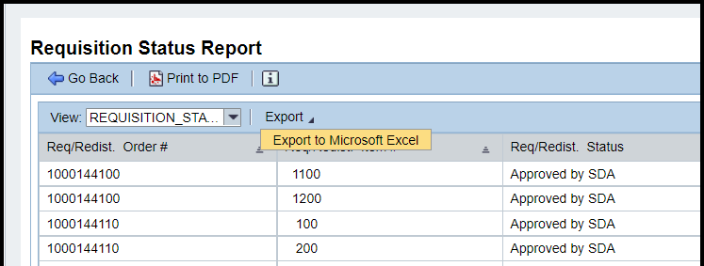
18
Running Requisition Status Report
7
Click Export to Microsoft Excel
Notes:
Review information on slide with RAs

Slide 19
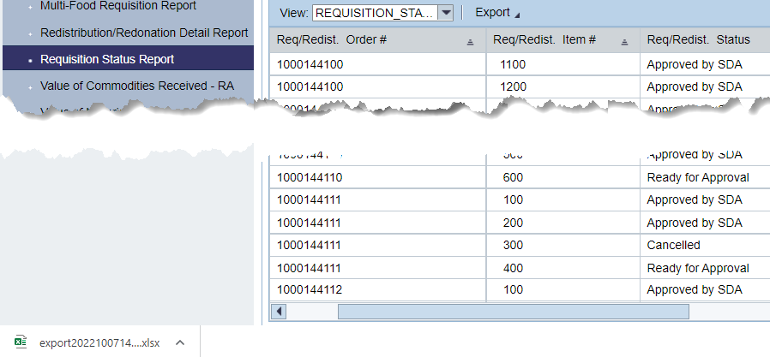
19
Running Requisition Status Report
Excel file will appear at the bottom of the screen. Click to open the file.
Notes:
Review information on slide with RAs

Slide 20
20
Running Requisition Status Report
May have to Enable Editing if presented with option before opening file.
Scroll bar at bottom to see all columns.
Notes:
The next slides will review the information located in each column of the Excel Report.

Slide 21
21
Running Requisition Status Report
Twenty-four columns of information found in Requisition Status Report
Scroll bar at bottom to see all columns.
Notes:
The next slides will review the information located in each column of the Excel Report.

Slide 22
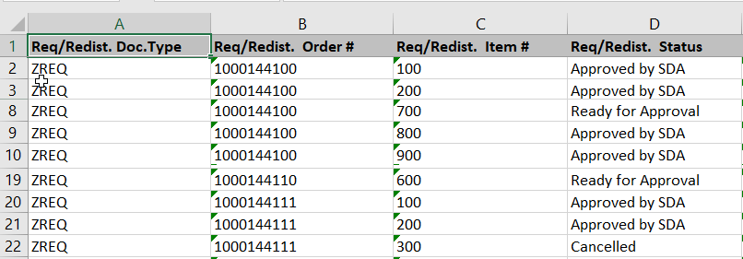
22
Running Requisition Status Report
Requisition/Redistribution Document Type
Hide this column if not needed
Notes:
Review information on slide with RAs

Slide 23
23
Running Requisition Status Report
Requisition or Redistribution Order Number
Can hide if not needed
Notes:
Review information on slide with RAs

Slide 24
24
Running Requisition Status Report
Item number identified on the requisition or redistribution order
Can hide if not needed
Notes:
Review information on slide with RAs

Slide 25
25
Running Requisition Status Report
Approval status for line item on the requisition or redistribution.
Notes:
Note: SDA=State Distributing Agency; in Texas, TDA is the State Distributing Agency

Slide 26
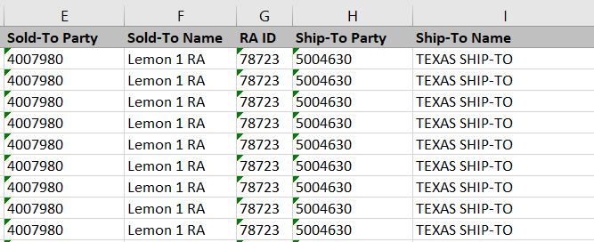
26
Running Requisition Status Report
RA WBSCM Customer ID #
Notes:
Review information on slide with RAs

Slide 27
27
Running Requisition Status Report
RA/Customer Name
Notes:
This column will show RA name in the Live Environment

Slide 28
28
Running Requisition Status Report
RA ID Number assigned by SDA
Notes:
Review information on slide with RAs

Slide 29
29
Running Requisition Status Report
Ship-To WBSCM ID Number
Ship-To Parties can include:
Direct Ship Warehouses
State Contracted Warehouses
Processors
Notes:
Review information on slide with RAs

Slide 30
30
Running Requisition Status Report
Name of Ship-To destination for material/line item
Ship-To Parties can include:
Direct Ship Warehouses
State Contracted Warehouses
Processors
Notes:
This column will show actual names of Ship-To organizations in Live Environment

Slide 31
31
Running Requisition Status Report
USDA Assigned Item/Material Number
Notes:
Review information on slide with RAs

Slide 32
32
Running Requisition Status Report
Item/Material Description.
Usually includes
a pack size
Notes:
Review information on slide with RAs

Slide 33
33
Running Requisition Status Report
Production Hierarchy
Material Grouping Categories
Can hide column if not needed
Notes:
Review information on slide with RAs

Slide 34
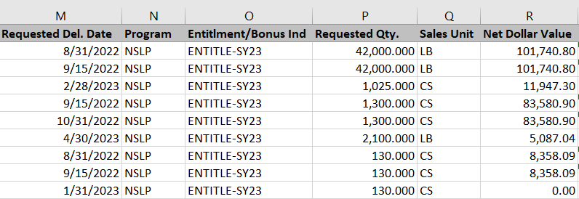
34
Running Requisition Status Report
Requested Delivery Date
Date RA requested material be delivered to Ship-To Destination (e.g. warehouse)
Ship-To Destinations include warehouse and processors.
Notes:
This is the date RAs selected materials be delivered to either the warehouse or processor they selected in each request.

Slide 35
35
Running Requisition Status Report
Program Program under which requisition(s) was placed
Notes:
Review information on slide with RAs

Slide 36
36
Running Requisition Status Report
Entitlement/Bonus Indicator Indicates whether material was requested using Entitlement or Bonus and the program year.
Notes:
Review information on slide with RAs

Slide 37
37
Running Requisition Status Report
Number of sales units of material requested by the customer (RA).
Notes:
Review information on slide with RAs

Slide 38
38
Running Requisition Status Report
Unit of Measure for line item in cases or lbs.
Notes:
Review information on slide with RAs

Slide 39
39
Running Requisition Status Report
Dollar value of material/line item
Notes:
Review information on slide with RAs

Slide 40
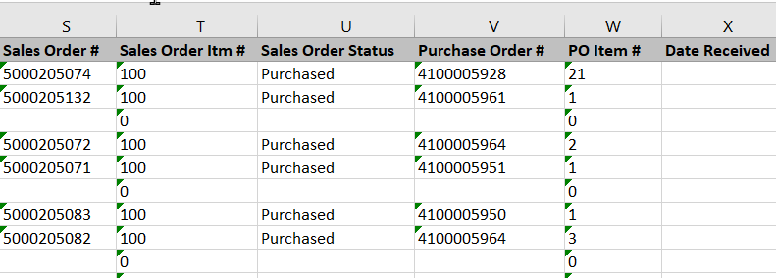
40
Running Requisition Status Report
USDA Assigned Sales Order Number Number associated with sales order in WBSCM
Notes:
Blank cells indicate no Sales Order has been created for that line item/request yet.

Slide 41
41
Running Requisition Status Report
Item/Line Number identified on Sales Order
Notes:
0s indicate no sales order has been created for that line item/request yet

Slide 42
42
Running Requisition Status Report
Status of the requisition/order
Notes:
Blank cells indicate Order has been purchased for that line item/request yet.

Slide 43
43
Running Requisition Status Report
Blank Status
Sales Order is created when TDA consolidates requests into a truckload
Blank boxes indicate no Sales Order has been created and line item is still in "Ready for Approval“ Requisition Status.
Notes:
Review information on slide with RAs

Slide 44
44
Running Requisition Status Report
Purchase Order Number
Notes:
Blank cells indicate no purchase order has been created for that line item/request yet.

Slide 45
45
Running Requisition Status Report
Line item on the Purchase Order
Hide column if not needed
Notes:
0s indicate no purchase order has been created for that line item/request yet

Slide 46
46
Running Requisition Status Report
Date material was received by the Ship-To location
Notes:
Review information on slide with RA

Slide 47
47
Requisition Status Codes
Status of the Requisition/Order
1) Ready for Approval | Requisition created by RA and submitted to SDA (TDA) for approval
2) Returned by SDA | Requisition returned by SDA (TDA) to RA for changes
3) Approved by SDA (TDA)* | Requisition processed and approved by SDA (TDA) and sent to USDA.
4) Approved by SpAgency | Order is being finalized and prepared for procurement by USDA. This leads to "On Invitation" and/or "Purchased" status.
5) Cancelled | Requisition cancelled by RA or TDA; Sales Order cancelled by USDA
6) On Invitation | Order that has been placed on a bid invitation by Food and Nutrition Services (FNS)
7) Returned by FSA/AMS | Returned by Farm Service Agency/Agricultural Marketing Service to TDA
8) Purchased/Price Final* | USDA purchased truck
9) Order Received* | Truck arrived at warehouse or processor
*Highlighted rows most frequently used by RAs
Notes:
Review information on slide with RA

Slide 48
48
04
Value of Commodities Received-RA Report

Slide 49
49
WHEN
WHY
Run this report after materials have arrived at the designated Ship-To Destination and have been receipted.
To review details on the value of commodities received. May be used during periods of financial reporting.
Notes:
Review information on slide with RAs

Slide 50
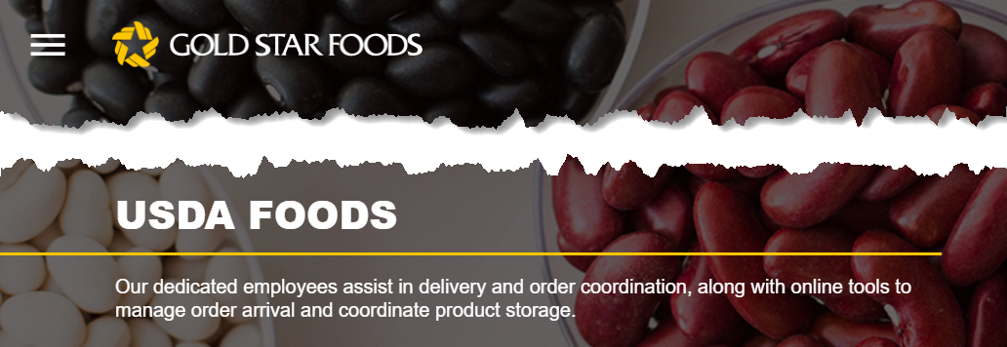
50
Commodities Received
Weekly Commodity Bulletin in TXUNPS
“Summary of Commodities in the Warehouse”
Will now be tracked in warehouse tracking systems
Notes:
Summary of Commodities received will no longer be found in TXUNPS
RAs will use warehouse tracking system for this information

Slide 51
51
Commodities Received
Weekly Commodity Bulletin in TXUNPS
“Summary of Commodities by Storage Type”
Will now be tracked in warehouse tracking systems
Notes:
Summary of Commodities by Storage Type will no longer be found in TXUNPS
RAs will use warehouse tracking system for this information

Slide 52
Training Portal Log-In
ESCs and RA Users Log In To WBSCM Training Environment
Login Required To Complete Assessment Questions URL: wbscmntrn.wbscm.usda.gov
RA Training Environment Username and Password previously provided via e-mail.
Note the "ntrn" section of web address
This indicates the training environment
Notes:
Highlight the difference between training environment vs. Production URLs.
Production environment does not have the "ntrn" component in the web address.
Logins previously provided via to RAs for training environment
Log in to training environment will be different from login to username for live system which occurs after all required training is complete.

Slide 53
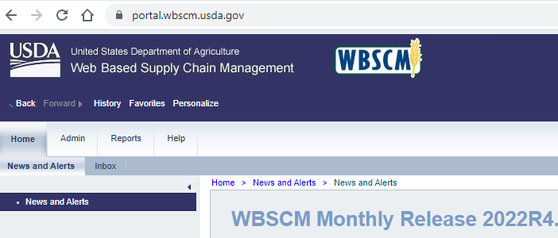
53
Running Value of Commodities Received-RA Report
To access the Value of Commodities Received-RA Report, follow the steps on each slide.
1
Click on reports
Notes:
To access the Value of Commodities Received RA Report, follow the next set of steps on each slide.​ ​
RAs would run this report to review the value of commodities received.
​
More detailed information will be provided on report view slides.

Slide 54
54
Running Value of Commodities Received-RA Report
2
Click on Value of Commodities Received-RA
Notes:
Review information on slide with RAs

Slide 55
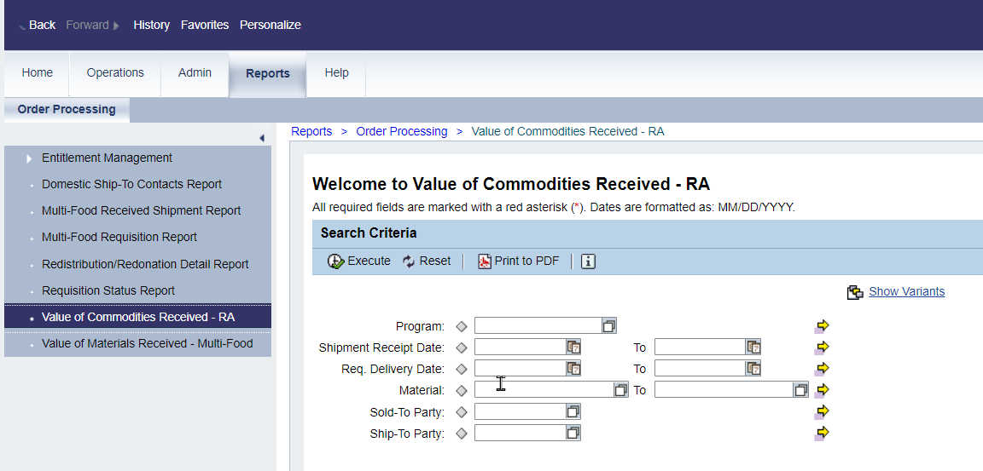
55
Running Value of Commodities Received-RA Report
Option 1: Type NSLP in Program Field
Option 2: To search, click on the Matchcode icon
3
Notes:
Review information on slide with RAs

Slide 56
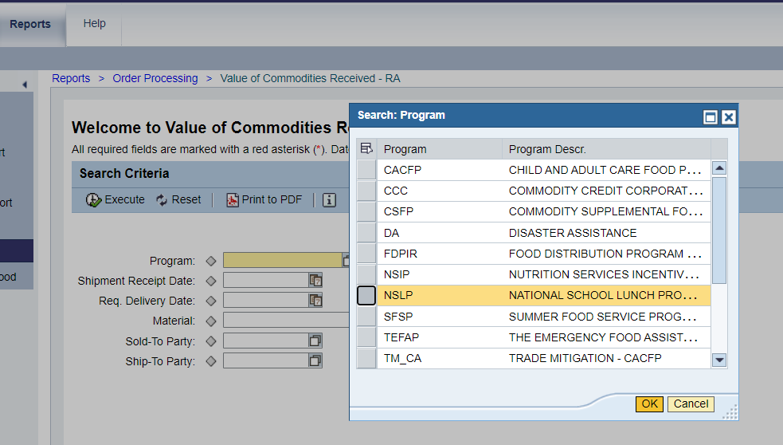
56
Running Value of Commodities Received-RA Report
3
Click on NSLP if using the pop-up box that appears after clicking on the Matchcode icon.
Notes:
Review information on slide with RAs

Slide 57
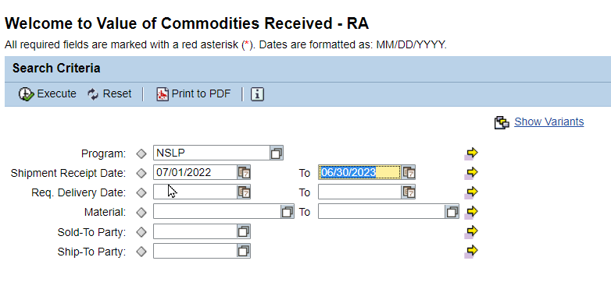
57
Running Value of Commodities Received-RA Report
4
Enter Date Ranges in Shipment Receipt Date field.
Notes:
To access staged data in the training environment for Value of Commodity Received Report, use the date range on slide.
Staged data for future program years is not available yet.
School/Program Year date range begins with July 1st to June 30th

Slide 58
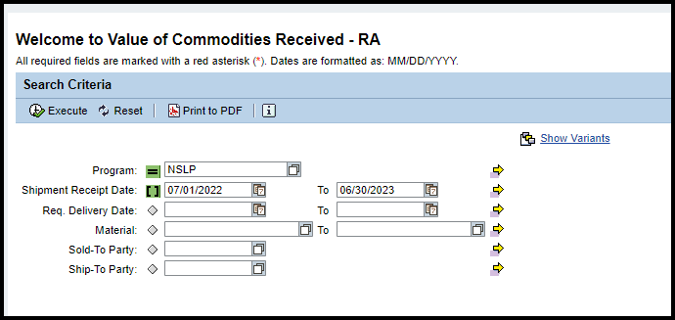
58
Running Value of Commodities Received-RA Report
5
Click Execute to run the report.
Notes:
Review information on slide with RAs

Slide 59
59
Running Value of Commodities Received-RA Report
6
Click Export
Notes:
Review information on slide with RAs

Slide 60
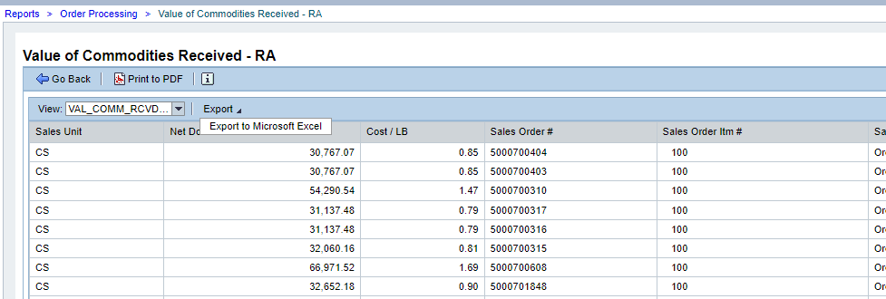
60
Running Value of Commodities Received-RA Report
7
Click Export to Microsoft Excel
Notes:
Review information on slide with RAs

Slide 61
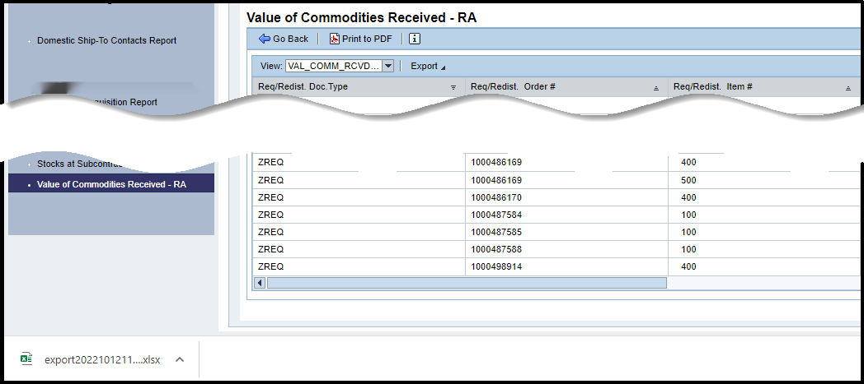
61
Running Value of Commodities Received-RA Report
Excel file will appear at the bottom of the screen. Click to open the file.
Notes:
Review information on slide with RAs

Slide 62
62
Running Value of Commodities Received-RA Report
Twenty-five columns of information found in Value of Commodities Received RA Report
Scroll bar at bottom to see all columns.
Notes:
Review information on slide with RAs

Slide 63
63
Running Value of Commodities Received-RA Report
Requisition/Redistribution Document Type
Hide column if not needed
Notes:
Review information on slide with RAs

Slide 64
64
Running Value of Commodities Received-RA Report
Requisition/Redistribution Order Number
Hide column if not needed
Notes:
Review information on slide with RAs

Slide 65
65
Running Value of Commodities Received-RA Report
Requisition/Redistribution Item Number
Hide column if not needed
Notes:
Review information on slide with RAs

Slide 66
66
Running Value of Commodities Received-RA Report
Requisition/Redistribution Status
Status of material while in requisition status.
Notes:
Review information on slide with RAs
SDA=State Distributing Agency, for Texas the State Distributing Agency is TDA

Slide 67
67
Running Value of Commodities Received-RA Report
Sold-To Party
Sold To Party ID #
Notes:
Review information on slide with RAs

Slide 68
68
Running Value of Commodities Received-RA Report
Sold-To Name
Notes:
Review information on slide with RAs

Slide 69
69
Running Value of Commodities Received-RA Report
RA ID Number
Notes:
Review information on slide with RAs

Slide 70
70
Running Value of Commodities Received-RA Report
WBSCM ID Number for Warehouse or Processor
Notes:
Review information on slide with RAs

Slide 71
71
Running Value of Commodities Received-RA Report
Ship-To Name
Name of Ship-To Organization
Can include warehouse or processor
Notes:
Review information on slide with RAs

Slide 72
72
Running Value of Commodities Received-RA Report
Material
USDA Assigned Item/Material Number
Notes:
Review information on slide with RAs

Slide 73
73
Running Value of Commodities Received-RA Report
Material Description
Item/Material Description
Notes:
Review information on slide with RAs

Slide 74
74
Running Value of Commodities Received-RA Report
Production Hierarchy
Material Grouping Categories
Hide column if not needed
Notes:
Review information on slide with RAs

Slide 75
75
Running Value of Commodities Received-RA Report
Requested Delivery Date
Date RA requested material be delivered to Ship-To Destination
Ship-To Destinations include warehouse and processors.
Notes:
Review information on slide with RAs
This date is the date RAs select materials to arrive at either the warehouse or processor they selected for each request

Slide 76
76
Running Value of Commodities Received-RA Report
Date Received
Date material was received at Ship-To Destination
Ship-To Destinations include warehouse and processors.
Notes:
Date received is the date material arrived at either the warehouse or processor the RA selected for each request

Slide 77
77
Running Value of Commodities Received-RA Report
Program
Program under which requisition(s) was placed
Notes:
Review information on slide with RAs

Slide 78
78
Running Value of Commodities Received-RA Report
Requested Quantity
Quantity of material requested by RA in cases or Lbs.
Notes:
Review information on slide with RAs

Slide 79
79
Running Value of Commodities Received-RA Report
Entitlement/Bonus Indicator Indicates whether material was requested using Entitlement or Bonus and the program year.
Notes:
Review information on slide with RAs

Slide 80
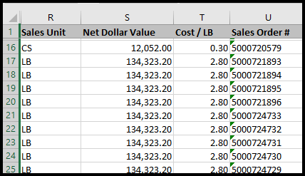
80
Running Value of Commodities Received-RA Report
Sales Unit
Unit of Measure in cases or Lbs.
Notes:
Review information on slide with RAs

Slide 81
81
Running Value of Commodities Received-RA Report
Net Dollar Value
Dollar value of cases/lbs.
Notes:
Review information on slide with RAs

Slide 82
82
Running Value of Commodities Received-RA Report
Cost of material by the Lb.
Notes:
Review information on slide with RAs

Slide 83
83
Running Value of Commodities Received-RA Report
Sales Order Number
USDA Assigned Sales Order #
Sales Order Numbers begin with the number 5.
Notes:
Review information on slide with RAs

Slide 84
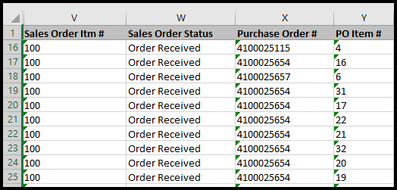
84
Running Value of Commodities Received-RA Report
Sales Order Item Number
Line number of material listed on Sales Order
Notes:
Review information on slide with RAs

Slide 85
85
Running Value of Commodities Received-RA Report
Sales Order Status
Status of the material
Items that have arrived at the Ship-To destination and have been receipted will appear in this report
All items on this report should appear as "Order Received"
Notes:
Line items showing “Order Received: indicates that those items have been received AND receipted.

Slide 86
86
Running Value of Commodities Received-RA Report
Purchase Order Number
Purchase Orders begin with the number 4
Hide column if not needed
Notes:
Review information on slide with RAs

Slide 87
87
Running Value of Commodities Received-RA Report
Purchase Order Item Number
Hide column if not needed
Notes:
Review information on slide with RAs

Slide 88
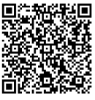
Knowledge Check:
Scan QR Code or visit the Link below to access the Knowledge Check
https://forms.office.com/r/bUNFgFYbLT
Notes:
RAs submit their responses via QR Code or link.
Allow for collaboration if desired.
Next slide shows Knowledge Check as a Matching Activity
Each click will reveal the matched term to appropriate purpose for running report.

Slide 89
Knowledge Check Match the report on the left to the appropriate purpose on the right.
WBSCM RA Reports
Purpose
A. To review details on the value of commodities received. May be used during periods of financial reporting.
B. To review how each item requested impacts entitlement balance and view how much entitlement is remaining.
C. To monitor the status and information for material line items through the order life cycle.
D. To obtain a summary or quick snapshot of beginning and remaining entitlement balances and bonuses.
Term
1.Requisition Status Report
2. Entitlement/Bonus Summary Report
3. Value of Commodities Received-RA Report
4. Entitlement/Bonus Detail Report
Notes:
TRAINER NOTE: Allow for collaboration if desired. Each click will reveal the matched term to appropriate purpose for running report.

Slide 90
90
Questions?
Notes:
Collect questions in all training settings to create FAQ for RA106

Slide 91
For WBSCM Assistance
See Contact Information Section on WBSCM Transition Page

Slide 92
Lab Time:
Notes:
RAs should explore executing, downloading, and reviewing reports in WBSCM training environment

Slide 93
93

Slide 94
94
Contact Us
https://squaremeals.org/Programs/FDPWBSCMTransitionProject.aspx
Diana Chavarria
CN Technical Support
Diana.Chavarria@esc15.net
325.658.6571

